Slide 1

Web Accessibility 101
Accessibility CoE | Cognizant Technology Solutions

Slide 2
Web Accessibility 101
1
Introduction to Accessibility
2
Overview of Assistive Technologies
3
Overview Accessibility Guidelines
4
How Accessibility Works?
5
HTML Techniques for Accessibility
7
Introduction to Accessible Rich Internet Media (ARIA)
8
Overview of Accessibility Assessment Techniques
9
Do-it-yourself: Evaluate and Fix Accessibility Issues

Slide 3
Introduction to
Accessibility

Slide 4
What is Accessibility?
As per the dictionary, Accessibility means:
Convenience
Ease of access
User-friendliness
Ease of understanding
Ease of use
Persons with disabilities are the most hit with
accessibility issues!

Slide 5
What is Disability?
As per WHO, Disability is an Umbrella Term Covering:
Problem in body function or structure
Difficulty encountered by an individual in executing a task or action
Problem experienced by an individual in involvement in life situations
Impairment
Activity Limitation
Participation Restriction

Slide 6

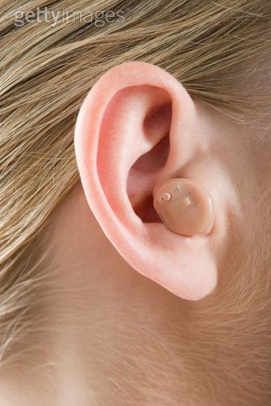

So who is a disabled?

Slide 7
Overview of Assistive Technology

Slide 8

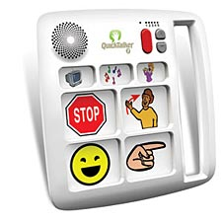
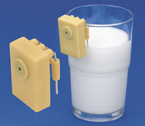
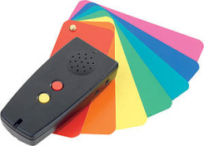
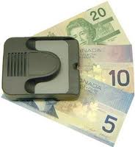
What is Assistive Technology (AT)
AT refers to any "product, device, or equipment, whether acquired commercially, modified or customized, that is used to maintain, increase, or improve the functional capabilities of individuals with disabilities."
1
2
3
4
5
Notes:
Nail clipper with a magnifier – helps low vision people including senior citizens
Picture cards – helps children with speech impairment
Liquid indicator – helps people with low vision and blindness
Color identifier – helps people with low vision and blindness
Money reader - – helps people with low vision and blindness

Slide 9
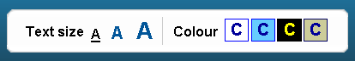
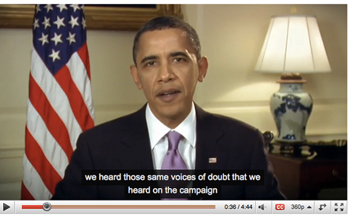
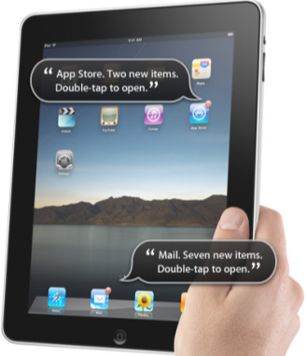
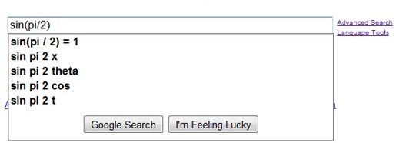
Assistive Technologies for Web

Slide 10
Types of Assistive Technology for Web
Impairment | Assistive Technology | Product
Visual impairment refers to when one or more parts of the eye or brain that are needed to process images become diseased or damaged, severe or total loss of vision can occur. Types: Total Blindness, Low vision, color blindness | Screen Reader : Interface between the computer’s operating system, its applications, and the user. The user sends commands by pressing different combinations of keys on the computer keyboard to instruct the speech synthesizer what to say and to speak automatically when changes occur on the computer screen. | JAWS NVDA WindowEyes VoiceOver (MAC)
 | Screen Magnifier : Enlarges text and graphics on a computer screen. It is loaded into the computer’s memory and functions similarly to a magnifying glass moving over a page, following the cursor, and magnifying the area around it. | ZoomText MAGic
 | Refreshable Braille display: Provide s access to information on a computer screen by electronically raising and lowering different combinations of pins in braille cells. | Focus Braille displays ALVA
Mobility Impairment range from lower body impairments, which may require use of canes, walkers, or wheelchairs, to upper body impairments which may include limited or no use of the upper extremities and hands. Types: Amputation, paralysis, Cerebral Palsy, Stroke, Multiple Sclerosis, Muscular Dystrophy, Arthritis, and spinal cord injury | Oversized trackball mouse: Designed for users with limited hand control, motor skill difficulty, hand-eye coordination challenges and/or involuntary muscle spasms. Features an oversized trackball with silky smooth movement that requires only the slightest touch | Penguin Vertical Mouse
 | Adaptive keyboard: Useful for users who does not have reliable muscle control in the hands for precision movements. Some adaptive keyboards have raised areas in between the keys, rather than lowered areas, to allow the person to first place the hand down on the keyboard, then slide the finger into the correct key. | Infogrip Adaptive Keyboard
 | Voice recognition software: Allows a person to control the computer by speaking. This assumes that the person has a voice that is easy to understand. | Dragon NaturallySpeaking
Cognitive Impairment refers to difficulty with one or more types of mental tasks than the average person. Types: Dyslexia, Dyscalculia , Dysgraphia, Autism, and ADHD | Reading and comprehension tools: Helps special education students with Learning Disabilities such as Dyslexia and ADD. Reads text aloud to students from digital, online, and print formats, providing reading, writing and test taking support from student to adult. | Kurzweil 3000

Slide 11
Demonstration: Screen Reader

Slide 12
Overview Accessibility
Guidelines

Slide 13
Web Content Accessibility Guidelines (WCAG)
What is WCAG?
Internationally recognized benchmark for accessibility of web content
Developed by the Web Accessibility Initiative – part of World Wide Web Consortium (W3C)
Agnostic guideline that can be applied any technology
WCAG Development Progress
WCAG 1.0 released in May 1999
WCAG 2.0 released in December 2008
Structure of WCAG 2.0
Conformance Levels
Principles
Guidelines
Success Criteria
Level A: Must be Achieved
Level AA: Should be Achieved
Level AAA: Can be Achieved
Recommended

Slide 14
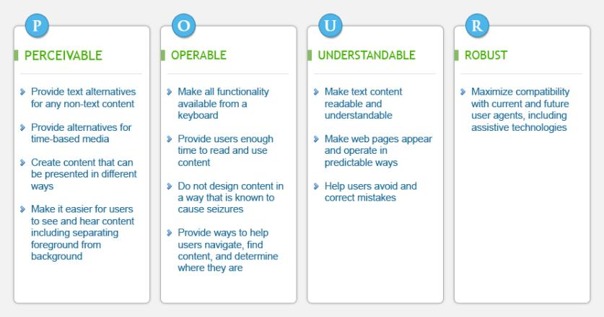
Principles of WCAG 2.0
Notes:
Perceivable
Information and user interface components must be presentable to users in ways they can perceive. This means that users must be able to perceive the information being presented (it can't be invisible to all of their senses)
Operable
User interface components and navigation must be operable. This means that users must be able to operate the interface (the interface cannot require interaction that a user cannot perform)
Understandable
Information and the operation of user interface must be understandable. This means that users must be able to understand the information as well as the operation of the user interface (the content or operation cannot be beyond their understanding)
Robust
Content must be robust enough that it can be interpreted reliably by a wide variety of user agents, including assistive technologies. This means that users must be able to access the content as technologies advance (as technologies and user agents evolve, the content should remain accessible)

Slide 15
WCAG 2.0 Framework
Principles | Guidelines | Level A | Level AA | Level AAA
1. Perceivable
1.1 Text Alternative
1.1.1
1.2 Time-based Multimedia
1.2.1 – 1.2.3
1.2.4 – 1.2.5
1.2.6 – 1.2.9
1.3 Adaptable (Info and Relationships)
1.3.1 – 1.3.3
1.4 Distinguishable (Color Contrast)
1.4.1 – 1.4.2
1.4.3 – 1.4.5
1.4.6 – 1.4.9
2. Operable
2.1 Keyboard Accessible
2.1.1 – 2.1.2
2.1.3
2.2 Enough Time
2.2.1 – 2.2.2
2.2.3 – 2.2.5
2.3 Seizures
2.3.1
2.3.2
2.4 Navigable
2.4.1 – 2.4.4
2.4.5 – 2.4.7
2.4.8 – 2.4.10
3. Understandable
3.1 Readable (Language of the page)
3.1.1
3.1.2
3.1.3 – 3.1.6
3.2 Operate in predictable ways
3.2.1 – 3.2.2
3.2.3 – 3.2.4
3.2.5
3.3 Help users avoid and correct mistakes
3.3.1 – 3.3.2
3.3.3 – 3.3.4
3.3.5 – 3.3.6
4. Robust
4.1 Compatible (HTML validations)
4.1.1 – 4.1.2

Slide 16
Accessibility Standards Across The Globe
WCAG is an international guidelines followed by various countries. Many countries have their own accessibility laws that needs to followed in addition to WCAG.
Country | Standard | Legislation | Applies To
Australia | WCAG 2 AA | Disability Discrimination Act | All government and non-government websites should comply with WCAG 2 AA by end of 2013
India | Guidelines for Indian Government Websites (based on WCAG 2 A) |  | WCAG 2 Level A became the standard for Indian government websites in February 2009.
United Kingdom | WCAG 1 AA or WCAG 2 AA | Equality Act 2010 | The COI standard for inclusive websites requires WCAG 1 AA or WCAG 2 AA for all UK government web sites. Other UK websites need to comply with the Equality Act and provide equal access, but this doesn't specify technical standards (although complying with at least WCAG 1 A or 2 A demonstrates that accessibility issues have been considered).
USA | Section 508 (subset of WCAG 1 with a few additions) | Section 508 of Rehabilitation Act | US federal agencies' websites must comply with Section 508 guidelines. These are currently being updated and will incorporate WCAG 2 AA - with the update planned to go into effect late 2013.
Read about other countries accessibility laws and guidelines: http://blog.powermapper.com/blog/post/Government-Accessibility-Standards.aspx

Slide 17
Accessibility Guidelines – Platforms
Platform | Guideline | Reference
Websites | WCAG 2.0 Level A and Level AA | http://www.w3.org/TR/WCAG/
Mobile Websites | Mobile Web Best Practices WCAG 2.0 Level A and Level AA | http://www.w3.org/TR/mobile-bp/ http://www.w3.org/TR/WCAG/
Mobile Applications | WCAG 2.0 Level A and Level AA | http://www.w3.org/TR/WCAG/
PDF | WCAG 2.0 Level A and Level AA | http://www.w3.org/WAI/GL/WCAG-PDF-TECHS/Overview.html
Flash | WCAG 2.0 Level A and Level AA | http://www.w3.org/TR/WCAG20-TECHS/flash.html

Slide 18
How Accessibility
Works?

Slide 19
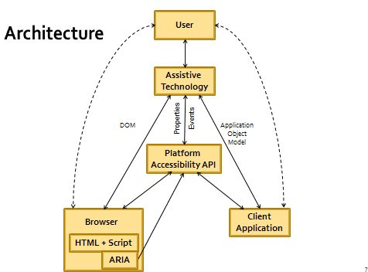
How Accessibility Works?
Source: Microsoft
Notes:
Assistive technology adds capabilities that the computer doesn't usually have. For example, a visually impaired user might employ assistive technology such as a screen reader and voice recognition, rather than directly using the application with the mouse and screen.
For applications on Microsoft platforms such as Windows or Windows Internet Explorer, and on the web, the assistive technology interacts with Microsoft UI Automation, Microsoft Active Accessibility, an application-specific object model such as the Document Object Model (DOM) in Internet Explorer, or some combination of these.
For Windows developers, UI Automation and Microsoft Active Accessibility provide an API to which they can write, to assign the appropriate accessibility properties and events. For web developers, certain HTML elements are mapped to Microsoft Active Accessibility and UI Automation objects, so in selecting those HTML elements, the developer can make use of the accessibility properties and events built in to those elements.
In both cases, the developer usually needs to be concerned only with ensuring that the API is correctly written to (or that the appropriate element is specified), in order for the application to be accessible, and need not be concerned with the wide variety of types of assistive technology in use ( see Figure 1).
Figure 1: Architecture of Accessibility APIs and assistive technology on Windows: the browser interprets HTML and Accessible Rich Internet Applications (ARIA) information, and exposes it to the same platform Accessibility API used by Windows applications.

Slide 20
Demonstration: Screen Reader and Keyboard

Slide 21
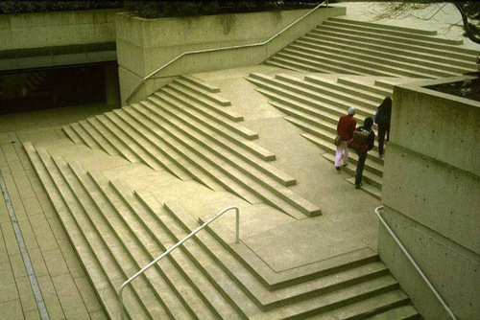
Accessibility Process
Accessibility starts right from design stage.
Incorporating accessibility from the start of a project increases the positive impact of designing for a broad constituency while decreasing development costs associated with accessibility when it is addressed much later.
Accessible design enables accessible development.
Accessibility is a shared responsibility amongst designers and developers.
Notes:
The image represent an example of accessibility design and development. A ramp is seamlessly integrated with steps to accommodate all types of users.

Slide 22
HTML Techniques for
Accessibility

Slide 23

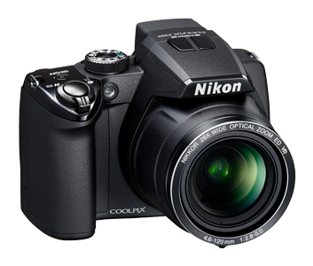
Images
How can blind users see images on web?
The ‘alt’ attribute of the image tag helps blind users see images on web.
<img src=“c183_2.jpg" alt=“Nikon Coolpix P100“/>

Slide 24
Types of Images
In order to create alternative text for an image it is necessary to determine what category an image belongs to.
Functional
Images for buttons, "Print", "Save", "E-mail", etc.
Separator - Differentiate sections of page (e.g. horizontal separator)
Informative
Concepts and Information - Charts, graphs, learning, historical (photographs), etc.
Images that enhance the themes or subject matter of the page content
Decorative
Images used for decoration, formatting, or that are invisible. e.g. spacer image, decorative curly lines, eye candy used simply to attract you to a page, gradients to make something look more pleasing – but don’t provide function or meaning
Meaning and function of the page would be the same without them
This is the only category that does not require alternative text -- more specifically null alt text must be provided when the element supports it (for web i.e. alt="")

Slide 25
How to write an Alternate Text?
Be accurate and equivalent in presenting the same content and function as presented by the image.
Be succinct. This means the correct content (if there is content) and function (if there is a function) of the image should be presented as succinctly as is appropriate. Typically no more than a few words are necessary, though rarely a short sentence or two may be appropriate.
NOT be redundant or provide the exact same information as text within the context of the image.
NOT use the phrases "image of ..." or "graphic of ..." to describe the image. It usually apparent to the user that it is an image. And if the image is conveying content, it is typically not necessary that the user know that it is an image that is conveying the content, as opposed to text.

Slide 26
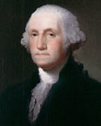
Context is everything!
Example 1
Example 2
Because of his role as the Commander in Chief of American forces in the Revolutionary War, and, later, the first President of the United States, George Washington is often called the "Father of his Country".
George Washington
Because of his role as the Commander in Chief of American forces in the Revolutionary War, and, later, the first President of the United States, George Washington is often called the "Father of his Country".
What would be appropriate alternate text?
"Image of George Washington"
"George Washington, the first president of the United States"
An empty alt attribute (alt="")
"George Washington"
What would be appropriate alternate text?
An empty alt attribute (alt="")
"Wikipedia entry for George Washington"
"Read More"
"George Washington"

Slide 27
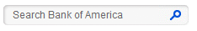



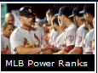
Examples: Text Alternative (1 of 2)
Image Button
Image & Text
alt=“Search”
alt = “ ”
alt =“email”
Logo
alt=“Cognizant Logo”
Social Media Logo
alt = “Cognizant on LinkedIn”
alt = “Follow Cognizant on Twitter”
alt = “Cognizant on Facebook”
Image Link
alt=“MLB Poweranks”
Grouped Images
<img src=“yellow-star.jpg“ alt=“ 1 out of 5 stars"/>
<img src=“silver-star.jpg“ alt=""/>
Icons
alt = “pdf file”

Slide 28
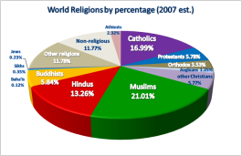

Examples: Text Alternative (2 of 2)
Chart
To offer a long description of an image, simply create a link (that is visible to anyone) to a page with the description. Such as Text Alternative for World Religion By Percentage Chart
Alternatively, provide text alternative below the image which would benefit all types of users.
It is not possible to add alternative text directly to background images. Images that convey content should not be placed in page or element backgrounds.
Longdesc attributed is not supported for any of major browsers thus it no longer recommended for complex images.

Slide 29
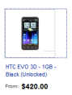
Links
Examples:
Type | Example | Recommended Solution
Non-clear link text | “Learn More”, “Read More”, “View All” | “Learn More about Discover Network” , “View All features”
Links opening new window/external web page | “Visit Pulse” | “Visit Pulse (opens in new window)“
Links associated with images |  | <a href=“newebay.com“> <img src=“new.gif“ alt="" />HTC EVO 3D – 1GB-Black (unlocked)</a>
Notes:
From the example URL, demo the below points:
Non – clear link text (View More , View Ad page)
Same link text moves to different destination
Links opening external window (In Footer MSDS)
Non – html Link (Coupon policy, Return Policy)
Additional Points:
Links with same link text should move to the same destination
Use access keys for commonly used links
Use title attribute to display additional information about link/function
More than one way to differentiate links from normal text

Slide 30
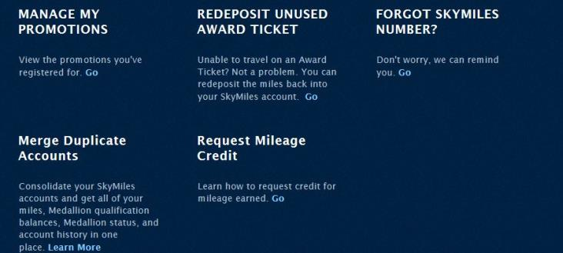
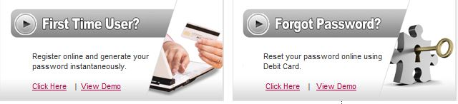
Examples
Links are not differentiated from normal text
Links with same link text moves to different destinations
Notes:
From the example URL, demo the below points:
Non – clear link text (View More , View Ad page)
Same link text moves to different destination
Links opening external window (In Footer MSDS)
Non – html Link (Coupon policy, Return Policy)
Additional Points:
Links with same link text should move to the same destination
Use access keys for commonly used links
Use title attribute to display additional information about link/function
More than one way to differentiate links from normal text

Slide 31
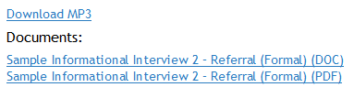

Audio
How do users with hearing impairment access audio content?
Provide text transcript of the audio in form of html page or some other format.
Example: http://breakingintowallstreet.com/biws/sample-informational-interview/
Sample text transcript word file for audio

Slide 32
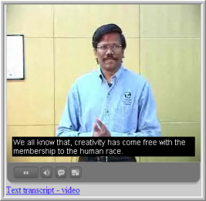
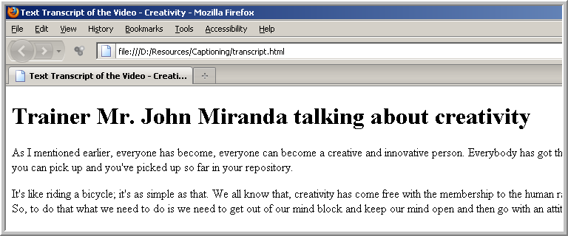
Video
How do Visually and Hearing Impaired person access video content?
Example: https://www.discover.com/company/corporate-responsibility/financial-education/index.html
Captions
Provide Text Transcript Link
Audio Description
Notes:
From the example URL, demo the below points:
No caption provided in the video.
No text transcript link found
In video there are some video which informs about how to hold the comb, hair etc. which is not covered in audio so we need audio description on the same.
Captions help hard of hearing people to understand the audio from video.
Audio description informs about the visual scene happening on the screen which is not covered in the audio.

Slide 33
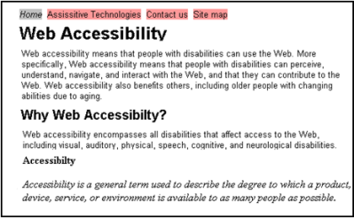
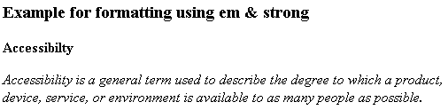
Semantic Markup
Example: http://corporate.familydollar.com/pages/careers.aspx
Structure web page using linear and meaningful heading levels.
<h1>Web Accessibility</h1>
<h2>Why Web Accessibility?</h2>
<h3>Accessibility</h3>
Do not use deprecated tags.
<strong>Accessibilty</strong>
<p>
<em>Accessibility is a general term used to describe the degree to which a product, device, service, or environment is available to as many people as possible.</em>
</p>
Notes:
From the example URL, demo the below points:
No header structure found.
<strong> Deprecated tags used for headers (Stores, Distribution center, Corporate)
Left navigations is not put in List.
Tables are used for the layout.

Slide 34
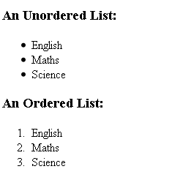
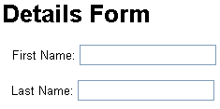
Semantic Markup
Use list to put content into a readable format.
<h3>An Unordered List:</h3>
<ul>
<li>English</li>
<li>Maths</li>
<li>Science</li>
</ul>
<h3>An Ordered List:</h3>
<ol>
<li>English</li>
<li>Maths</li>
<li>Science</li>
</ol>
Do not use tables for layout, create div based layout
<div id="fname">
<label for="FirstName"> First Name:</label>
<input name="FirstName" type="text" id="FirstName" value=””>
</div>
<div id="lname">
<label for=“LastName"> Last Name:</label>
<input name=“LastName" type="text" id=“LastName" value=””>
</div>

Slide 35
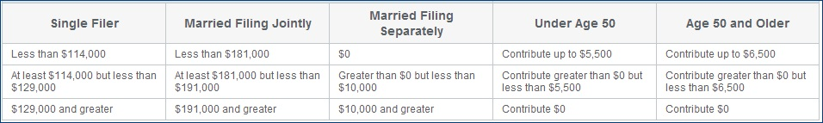
Tables
Example: https://www.discover.com/online-banking/retirement/ira-income-limits.html
Notes:
From the example URL , show the below points:
No summary / captions attribute found.
Data is not associated with the header

Slide 36
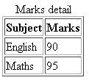
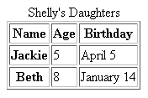
Tables
Provide Caption/Summary attribute
<table summary=”Table listing subject and marks of a student” border="1">
<caption>Marks detail</caption>
<tr>
<th scope=”col”>Subject</th>
<th scope=”col”>Marks</th>
</tr>
<tr>
<td>English</td>
<td>90</td>
</tr>
<tr>
<td>Maths</td>
<td>95</td>
</tr>
</table>
Use scope attribute
<table border="1" align="left">
<caption>Shelly's Daughters</caption>
<tr>
<th scope="col">Name</th>
<th scope="col">Age</th>
<th scope="col">Birthday</th>
</tr>
….
</table>

Slide 37
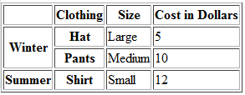
Tables
Use id and headers attribute for complex tables
<tr>
<td>&nbsp;</td>
<th id=“clothing">Clothing</th>
<th id=“size">Size</th>
<th id=“cost">Cost in Dollars</th>
</tr>
<tr>
<th rowspan="2" id=“winter">Winter</th>
<th id=“hat">Hat</th>
<td headers=“winter hat size">Large</td>
<td headers=“winter hat cost">5</td>
</tr>
Avoid using row span or column span
Use abbr attribute effectively

Slide 38
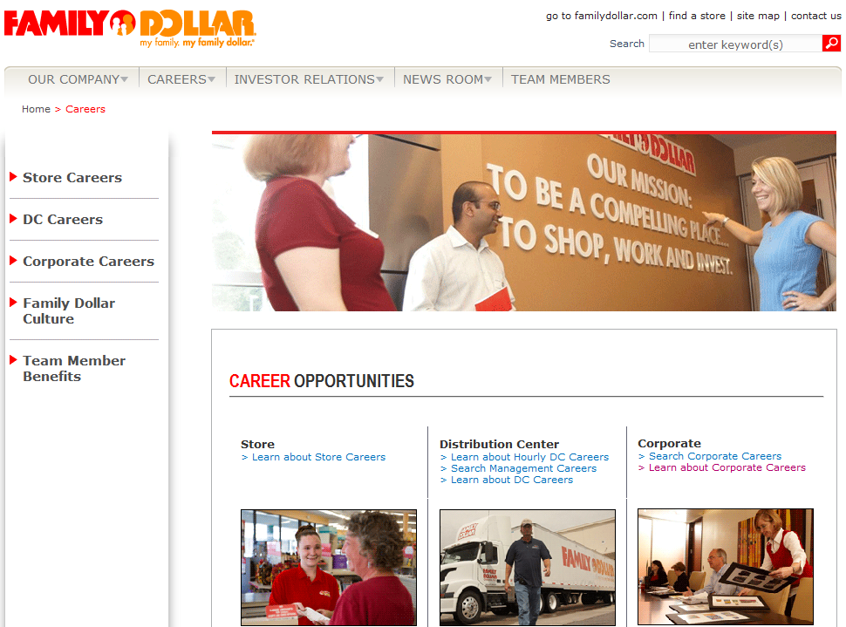
Reading Order
Bring a sequential order between the content in the web page
Example: http://corporate.familydollar.com/pages/careers.aspx
Notes:
Problem:
When the keyboard focus is on "Learn about Store careers" (link) under Store, if tab key is pressed, it moves to "Distribution Center" section.
Solution:
The content below "Learn about Store careers" link should be read after "Learn about Store careers" link.

Slide 39
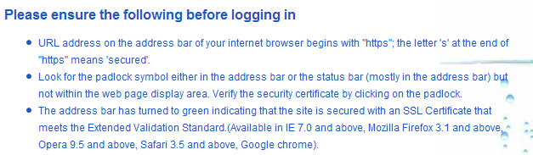
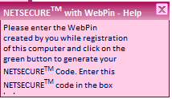
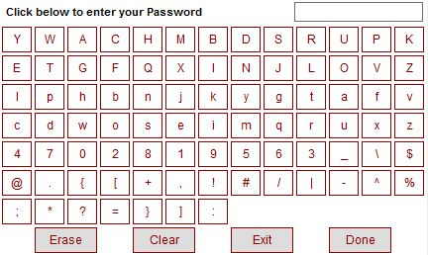
Instructions
Do not rely upon shape, size, color, visual location for conveying information.
Example: https://www.onlinesbi.com/retail/login.htm?whatfld=abt_bank

Slide 40
Colors
Ensure that the colors are accessible.
Contrast ratio between foreground and background color should be sufficient.
Font <= 14 pt - Minimum Contrast Ratio >= 4.5:1
Font >= 14 bold OR 18 - Minimum Contrast Ratio >= 3.0:1
The color contrast of the background and the foreground is not sufficient.
This contrast ratio is better.
Contrast Ratio: 1.2:1
Contrast Ratio: 9.7:1

Slide 41
Text Resize
Do not use absolute font sizes, instead use relative font size.
Avoid using absolute measuring units such as px, use em instead.
The font size along with the background should increase/decrease proportionately according to user preference.
Example: http://www.familydollar.com/pages/home.aspx
Notes:
In example show the below points:
Text size in IE is not increasing.
Page distorts in mozilla when text is resized.

Slide 42
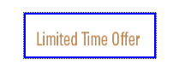
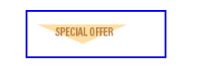
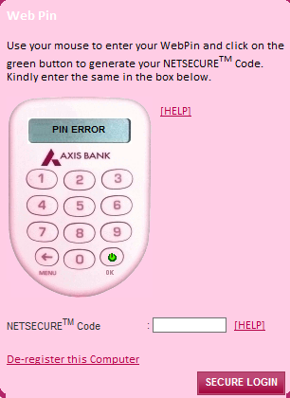
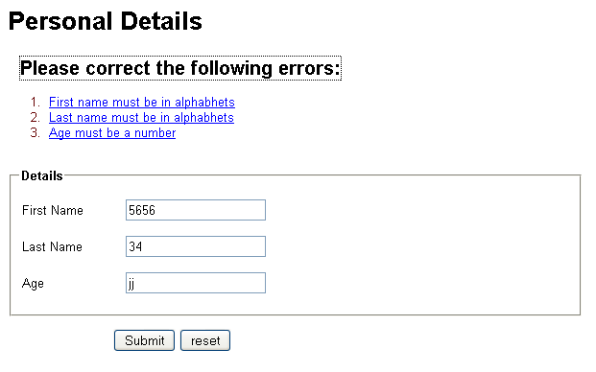
Keyboard
Ensure all web elements are available via Keyboard
Use device independent events
Example: http://www.familydollar.com/pages/home.aspx
OnMouseOver / Onfocus OnBlur / OnMouseOut
Keyboard focus should be clearly visible
Notes:
From the example URL, demo the below points:
Focus carrot is not visible on Facebook, Twitter, Get mobile alerts images
Sub menus are not available via keyboard

Slide 43

Time limit
Provide mechanism to pause/stop automatically moving or scrolling content .
If an application has a time limit, then user should be given an option to turn off, adjust or extend the time limit.
Mechanism needs to be provide to stop/pause automatically playing audio.

Slide 44
Auto Update
Example: http://www.icicipruamc.com/Homepage.aspx
Best Practice
Inform the user in advance before updating the content
Notes:
In example show the content changes without informing the user.

Slide 45
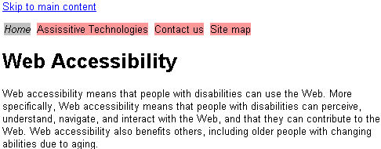
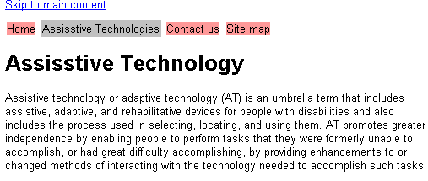
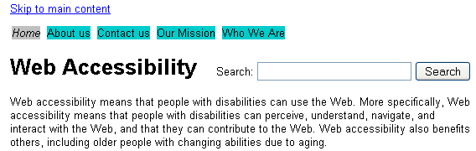
Consistent Navigation
Similar order of navigation
Similar labels/identification mechanism of repeated elements

Slide 46
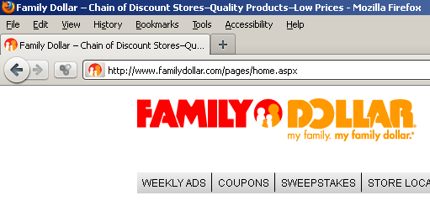
Page Titles
Page title is the first thing that the screen reader users encounter on a web page, thus it is very important to provide a descriptive and informative title for a page.
Title of the home page i.e. “Family Dollar – Chain of Discount Stores–Quality Products–Low Prices” does not inform the user that it is the home page. Screen reader user will not get the accurate information with current page title.
Ensure that title of all the pages are descriptive enough to inform the purpose of the page.
Eg: The page title of the home page could be “Family Dollar – Chain of Discount Stores–Quality Products–Low Prices | Home. User will understand that they are on the home page by reading this title.

Slide 47
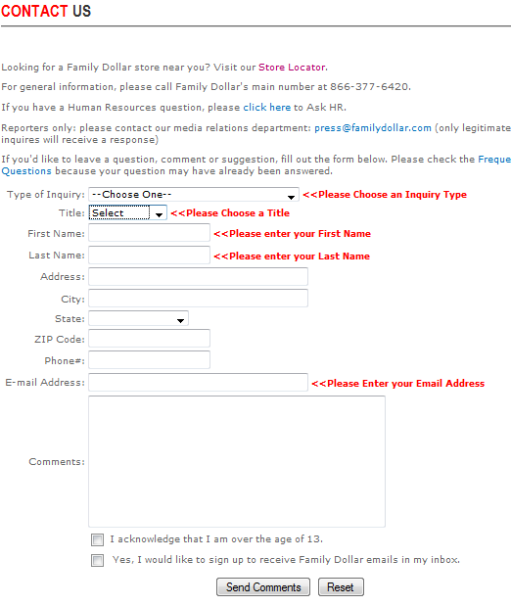
Forms
Example: http://corporate.familydollar.com/pages/contactus.aspx
Instructions are not provided. Example Required fields
label are not associated with each form element.
No mechanism is provided to jump to the respective error element.
On click of “send comments” button, errors occur, but errors are not available to screen reader users.

Slide 48
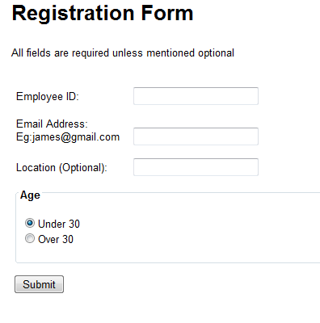
Forms
Provide clear instructions. Instructions should not rely upon color, shape or visual location.
Associate label with each form element.
<label for="txt_employeeId">Employee ID:</label>
Provide additional information to fill a form element, if required.
<label for="txt_email">Email Address:<br/>Eg:james@gmail.com</label>
Use fieldset and legend to group similar form elements.
<fieldset>
<legend>Age</legend>
<ul>
<li><input type="radio" name="age" id="under30" checked="checked" /><label for="chk_red">Under 30</label></li>
<li><input type="radio" name="age" id="over30"/><label for="chk_singing">Over 30</label></li>
</ul>
</fieldset>

Slide 49
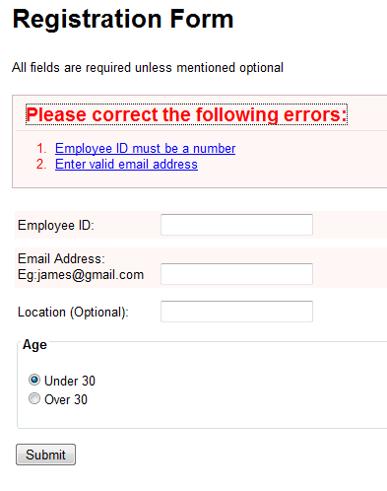
Forms
Example:
https://www.harmonyhpi.com/contactus/contactus/report
Provide a mechanism to jump to the respective error element when error suggestion is clicked.
On click of the Submit button, if errors occur, move the focus to area where errors have occurred.

Slide 50
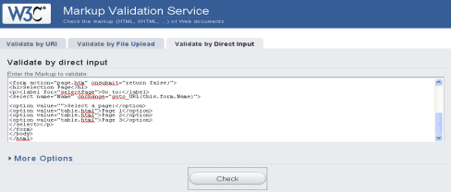
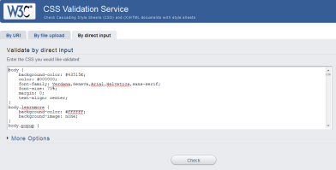
Valid Code
W3C HTML Validation
Adhere to W3C Standards it helps in creating error free code.
HTML Validation URL:
http://validator.w3.org/
W3C CSS Validation
CSS Validation URL:
http://jigsaw.w3.org/css-validator/

Slide 51
Accessible Rich Internet Application (ARIA)

Slide 52
Why ARIA?
Since HTML only has native support for a few user interface controls (links and form elements), developers often create their own controls using a combination of HTML elements and script.
The script changes the purpose (role) and state (properties) of the HTML elements used to build the controls, but these changes are not exposed to Assistive technology (AT).
To overcome this problem a new solution evolved: Accessible Rich Internet Applications (ARIA).
ARIA is W3C’s recommendation that extends HTML with additional attributes designed to convey custom semantics. These attributes are used by browsers that ARIA to pass along the controls’ state and role to the accessibility API.
The most common problems that this addresses are:
Keyboard interaction (tabindex)
Exposing the purpose and state of a control (role and properties)
Exposing the purpose of content (landmark roles)
Exposing changes in content (live regions)

Slide 53
ARIA Core Components
Roles: <form role="search">
alert, button, checkbox, header, img, slider, navigation, widget, etc.
States: <input aria-disabled="true">
aria-checked, aria-pressed, aria-grabbed, aria-hidden, etc.
Properties: <input aria-required="true">
aria-describedby, aria-labelledby, aria-live, aria-required, aria-valuemax, etc.
More ARIA Properties - http://test.cita.illinois.edu/aria/

Slide 54
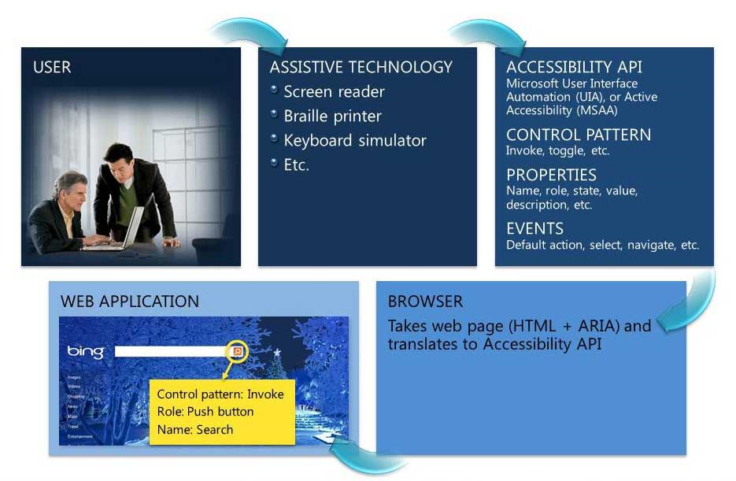
How ARIA Works?
Notes:
Web Accessibility Technical Overview: The browser maps values from HTML and ARIA to the Accessibility API. AT makes use of that information in the same way as it does for a Windows application, exposing it to the end user.

Slide 55
ARIA Support
Browser | Minimum Version | Notes
Firefox | 3.0+ | Works with NVDA, JAWS 10+ and Orca
Chrome | Latest | Screen reader support still experimental as of Chrome 15
Safari | 4+ | Safari 5 support is much improved. Live region support requires Safari 5 with VoiceOver on iOS5 or OS X Lion
Opera | 9.5+ | Requires VoiceOver on OS X. TBD: how well does this currently work?
Internet Explorer | 8+ | Works with JAWS 10+ and NVDA. No live region support in NVDA. IE9 support is much improved.
Assistive Technology | Minimum Version for basic ARIA | Minimum version for live region and alert support
NVDA | 2010.2 (NVDA is always a free upgrade) | 2011.1 for Firefox, no live region support in IE as of 2011.2.
Orca | ? (TBD) | ? (TBD)
VoiceOver | OSX 10.5, iOS 4 | OS X 10.7 iOS 5
JAWS | 8 | 10
Window-Eyes | 7 | No live region support currently
ZoomText | ? | No live region support currently

Slide 56
Demonstration: ARIA Examples

Slide 57
Mobile Accessibility

Slide 58
Accessibility Mobile Best Practice
Use Native UI Components
Set accessibility attributes for every element
Follow Mobile OS accessibility best practices
Adopt WCAG 2.0 and MWBP 1.0
Use web standards – HTML, CSS, Javascript
Use progressive enhancement
Test your designs with Assistive Technology, there is no excuse!
Test with real people who have real accessibility needs
Iterate and test again!

Slide 59
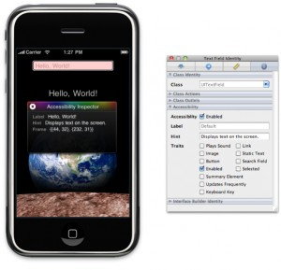
iOS Accessibility Attributes
Label: A short, localized word or phrase that succinctly describes the control or view, but does not identify the element’s type. Examples are “Add” or “Play.”
Traits: A combination of one or more individual traits, each of which describes a single aspect of an element’s state, behavior, or usage.
Hint: A brief, localized phrase that describes the results of an action on an element. Examples are “Adds a title” or “Opens the shopping list.”
Frame: The frame of the element in screen coordinates, which is given by the CGRect structure that specifies an element’s screen location and size.
Value: The current value of an element, when the value is not represented by the label. For example, the label for a slider might be “Speed,” but its current value might be “50%.”

Slide 60
VoiceOver Gestures
Tap: Speak item.
Flick right or left: Select the next or previous item.
Two-finger tap: Stop speaking the current item.
Two-finger flick up: Read all, from the top of the screen.
Two-finger flick down: Read all, from the current position.
Double-tap: Activate selected item.
Twist fingers: Activate rotor, select element
Flick up or down: The effect varies depending on the Rotor Control setting.
Three-finger flick up or down: Scroll one page at a time.
Three-finger flick right or left: Go to the next or previous page (for example, on the Home screen or in Safari).

Slide 61
Android Talkback Gestures
When TalkBack and Explore by Touch are turned on, you can use simple gestures to navigate your device:
Drag one finger. Explore your screen and hear audible feedback for what is being touched.
Double-tap anywhere on the screen. Opens or activates the item that you last touched.
Swipe up or down using two fingers. Scroll lists and pages.
Swipe left or right using two fingers. Change pages and screens.
Swipe right (or down) using one finger. Move to the next item.
Swipe left (or up) using one finger. Move to the previous item.
Swipe down then up using a single motion. Transition to the next reading level when reading blocks of text, then swipe right to read forward or left to read backward.
Swipe up then down using a single motion. Transition to the previous reading level when reading blocks of text, then swipe right to read forward or left to read backward.
Swipe right then left using a single motion. Move to the next piece of information.
Swipe left then right using a single motion. Move to the previous piece of information.

Slide 62
Android Talkback Gestures
TalkBack has shortcut gestures to help you get to your Home screen, go back, and more. To try these shortcuts, swipe using a single motion:
Up then right: Open local context menu
Up then left: Home button
Down then right: Open global context menu
Down then left: Back button
Right then down: Open notifications
Left then up: Recent apps button
You can modify your shortcut gestures and the corresponding actions in TalkBack by going to Settings > Accessibility > TalkBack > Settings > Manage shortcut gestures.

Slide 63
Accessibility Assessment
Techniques

Slide 64
Testing Techniques/Tools
Element | Techniques/Tools
Images | Screen reader Checking code Disabling images Checking appropriateness of alternate text Observing manually
Links | Screen reader Checking appropriateness of the link text Checking if the link is redundant Observing manually
Audio | Test transcript
Video | Captioning Text transcript Audio description

Slide 65
Testing Techniques/Tools
Element | Techniques/Tools
Semantic Markup | Checking code Screen reader HTML validation
Tables | Checking code Screen reader
Instructions | Appropriateness of instruction
Color | Color contrast analyzer
Text Resizing | Browser Observing Manually
Keyboard | Keyboard Checking code

Slide 66
Testing Techniques/Tools
Element | Techniques/Tools
Time limit | Manual Observation
Auto-update | Manual Observation
Consistent Navigation | Manual Observation
Forms | Screen reader HTML Validation Keyboard Checking code Manual observing
Validation | W3C HTML/CSS Validation Service Worldsapce

Slide 67
Do-it-Yourself

Slide 68
Web Accessibility Testing
Lets test - http://www.nbcu.org/
Create Accessibility Assessment report:
http://www.unitedhealthgroup.com/
http://www.medassets.com/Pages/Default.aspx

Slide 69

Thank You!
If you have any queries please reach out to us @
CI Accessibility CoE@cognizant.com

